Slide 1

Media Creation by Conversion
Data Doppelgänger
Lane Snively
Quinton Hetland

Slide 2
Team
Lane Snively
Algorithms Design / Analysis
Art
Functional Programming
Mathematics
Quinton Hetland
Algorithms Design / Analysis
Big Data
Functional Programming
Mathematics

Slide 3
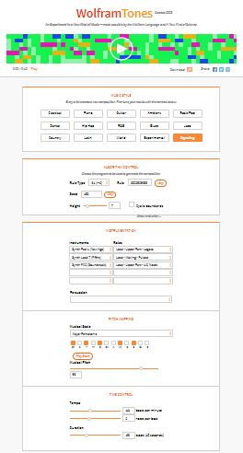
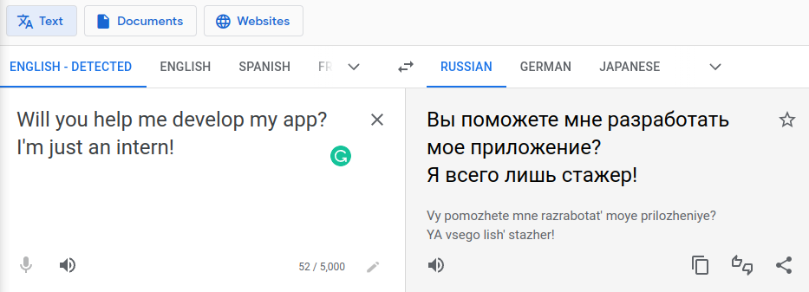

Slide 4
Google Translate:
Convert one language to another
English -> Spanish
French -> Japanese
Arabic -> Russian
…
Data Doppelgänger:
Use input media file to convert to another media type
text -> image
text -> video
text -> sound
image -> image
image -> video
image -> sound
video -> image
video -> video
video -> sound
sound -> image
sound -> video
sound -> sound

Slide 5
A Unique Method of Media Creation
PROBLEM
AI algorithmically converts existing media into new media based on its settings
A collection of users get identical output with the same input
SOLUTION
Our method algorithmically converts existing media into new media based on user settings
A collection of users have the choice to get identical results with the same input or get unique results

Slide 6
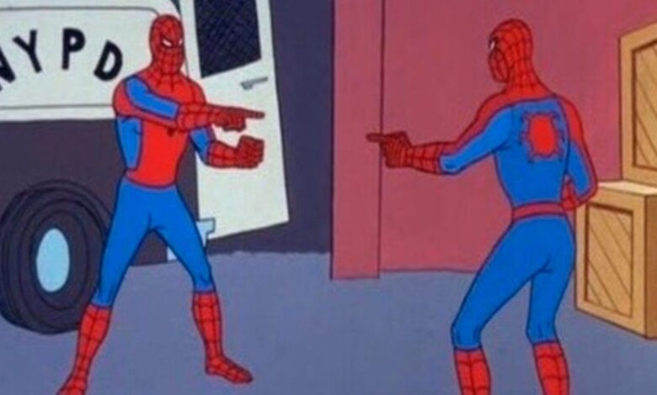
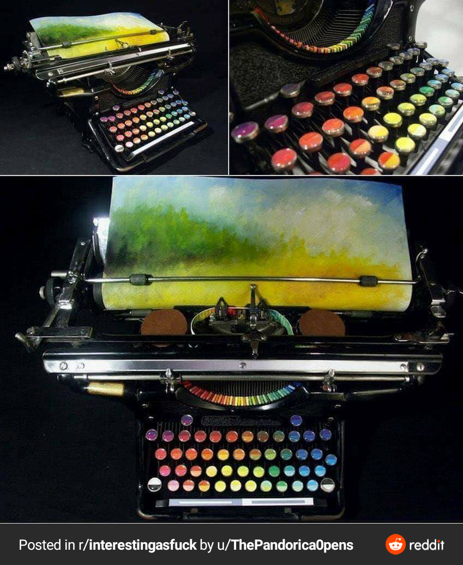
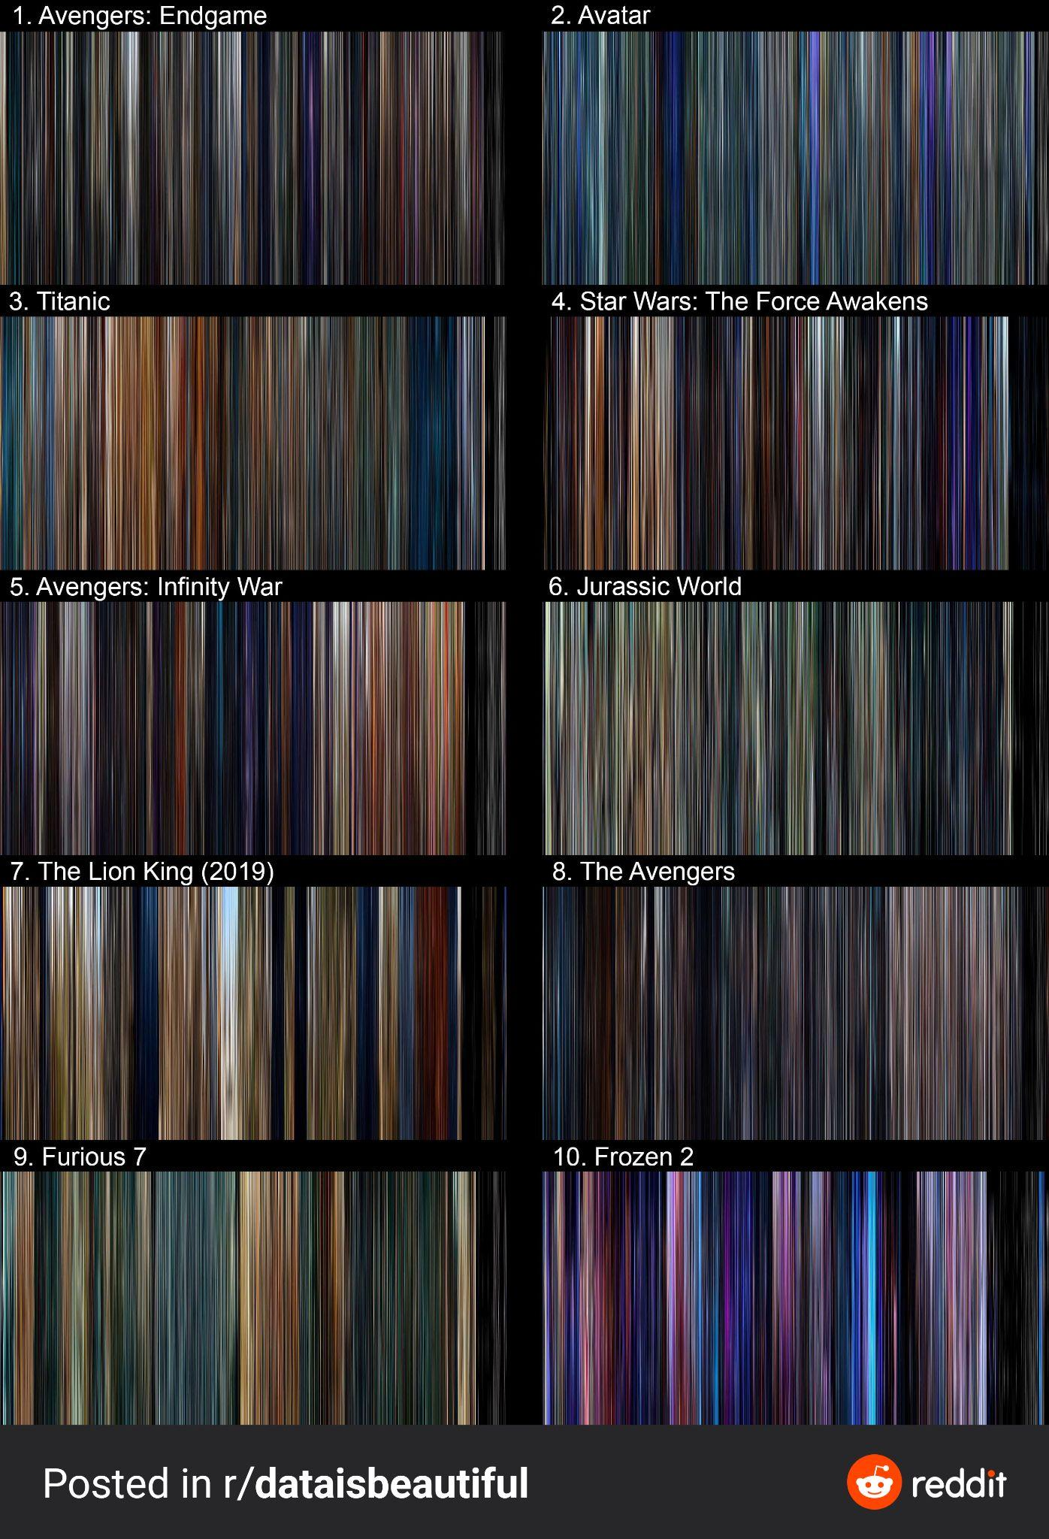
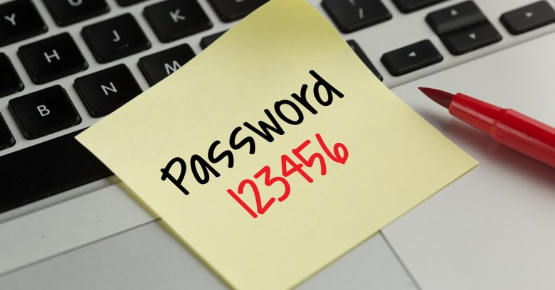
Uses
Image → password
Music / art generation from text
Sentiment analysis

